Slide 1

#ItStartsWithAStory

Slide 2

The problem
Children always struggle to understand text.
Notes:
Start with a story, I remember when I was young, we used to learn the values in texts. “You have to be honest… ” but we were lucky, we watched these value in the old cartoons and we really understood them..

Slide 3

The proposed solution
Hakawati AR is a application that smooth the learning experience
HAKAWATI AR
Notes:
Senses ()
Statis
65% visual learners
30% auditory learners

Slide 4




Value Proposition
Edutainment
Deep Understanding
Increase Income

Slide 5






Competitors Benchmarks
Market Validation
Augmented Reality
Platform
Story
Audible
Arabic

Slide 6
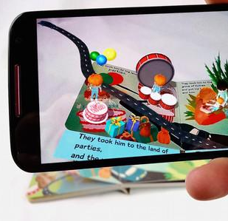
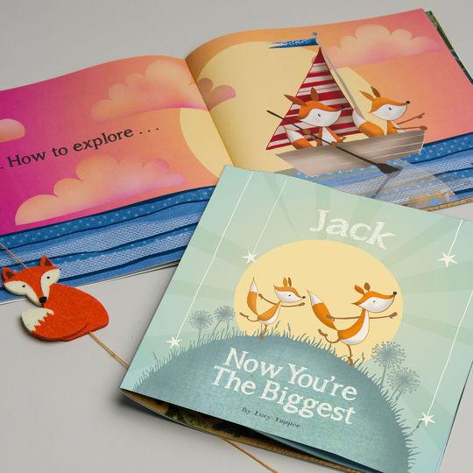

How it works
Mobile Phone
BOOKS

Slide 7


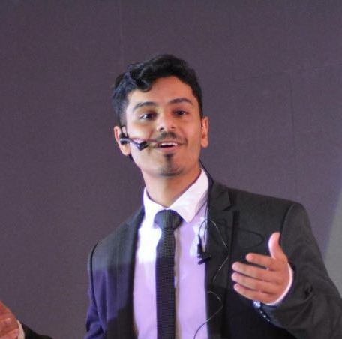

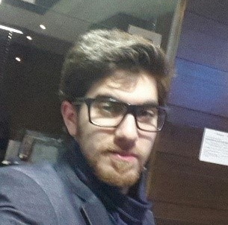
Team Members
Faisal Alshmrani
Omar Sami
Abdullah Bamashmos
Mohammed Shalaby
Mohammed Molham

Slide 8
